Slide 1
The Enigma of Unlabeled Positives -- Using ML to Detect and Predict Restatements Lanxin Jiang, Abby Zhang, Miklos Vasarhelyi CAR Lab Advisory Board meeting, Nov. 4th, 2021

Slide 2
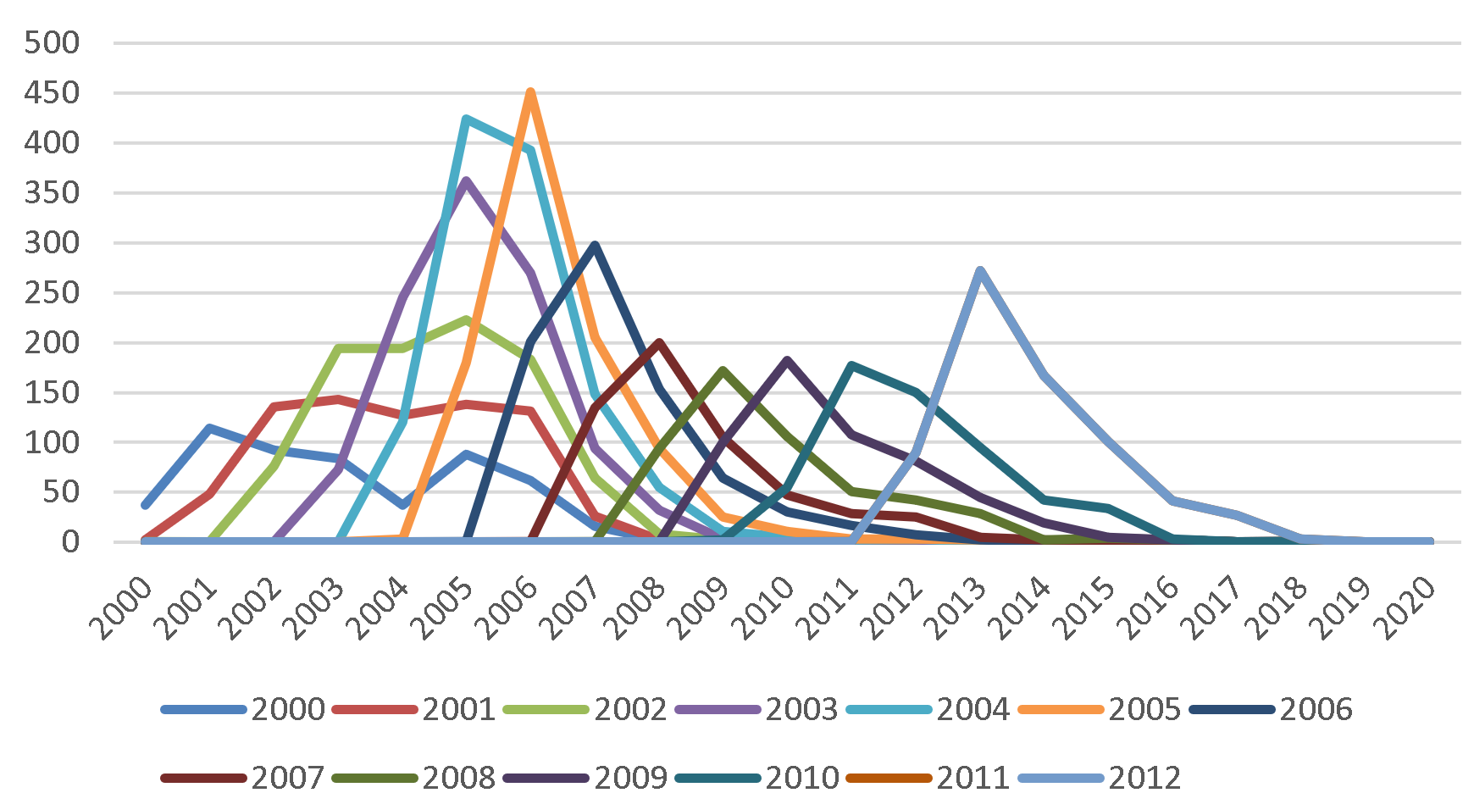
Motivations
Prior research mostly adopts supervised learning to predict and detect restatements, assuming that the dataset has complete labels. However, in the setting of restatement, only positively labeled data are available, and an absence of a restatement label does not promise a clean financial report.
We introduce a methodology called PU Learning that is currently commonly applied to partially labeled dataset in other domains.
The issue of the lack of labeled data in restatement dataset

Slide 3
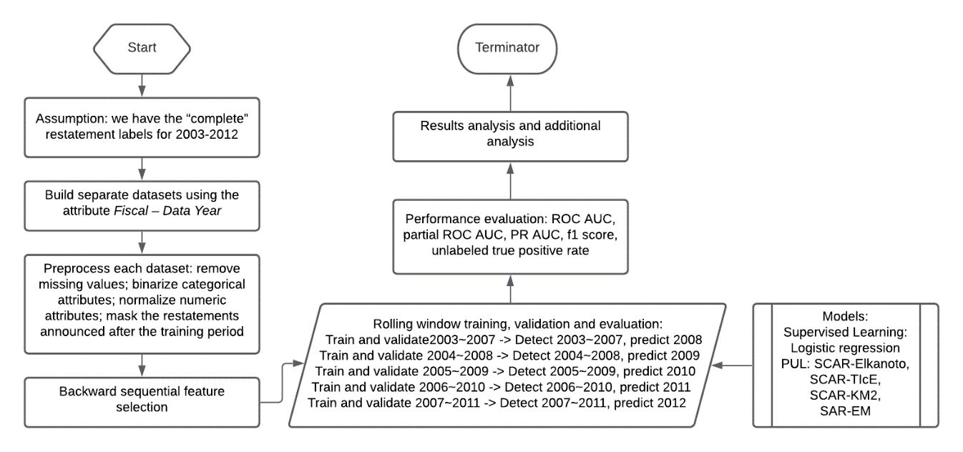
Design and Results
The experiment design
We demonstrate that PU Learning is better than supervised learning in detecting and predicting restatements, especially those unlabeled positives.
The finding can inspire future accounting research to adopt semi-supervised learning in studying accounting events that similar features, such as fraud and accounting misconduct.

